Slide 1
GAME DESIGN PROPOSAL
RAVEN MORTIMER
&
BUU NGUYEN

Slide 2
IDEA 01

Slide 3
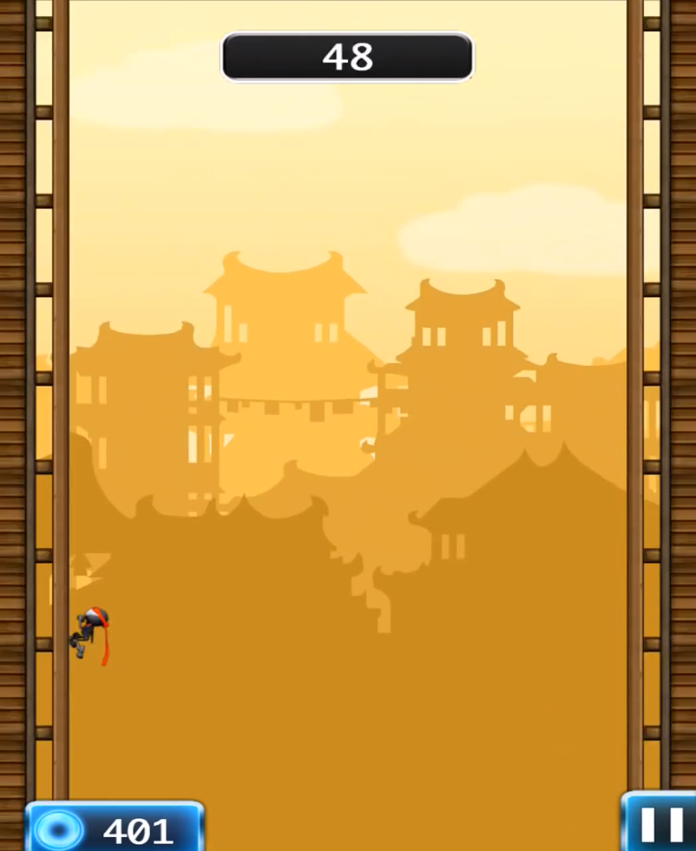
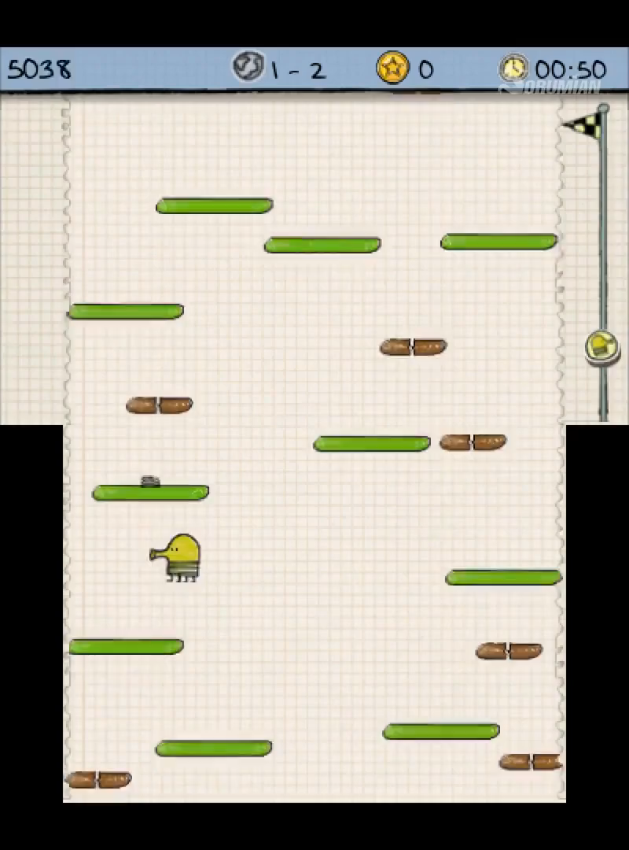
2D ENDLESS JUMPER

Slide 4
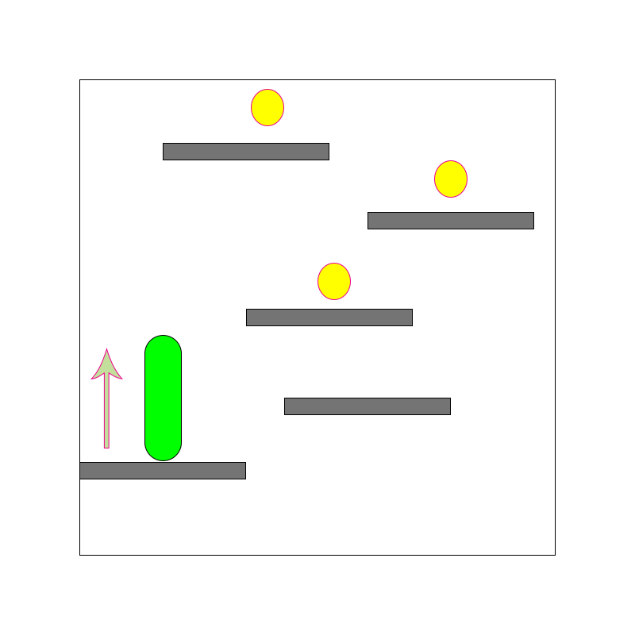
iJump
Endless jump
Power-up pick up
Money pick up
Booster Shop
High Score Record

Slide 5
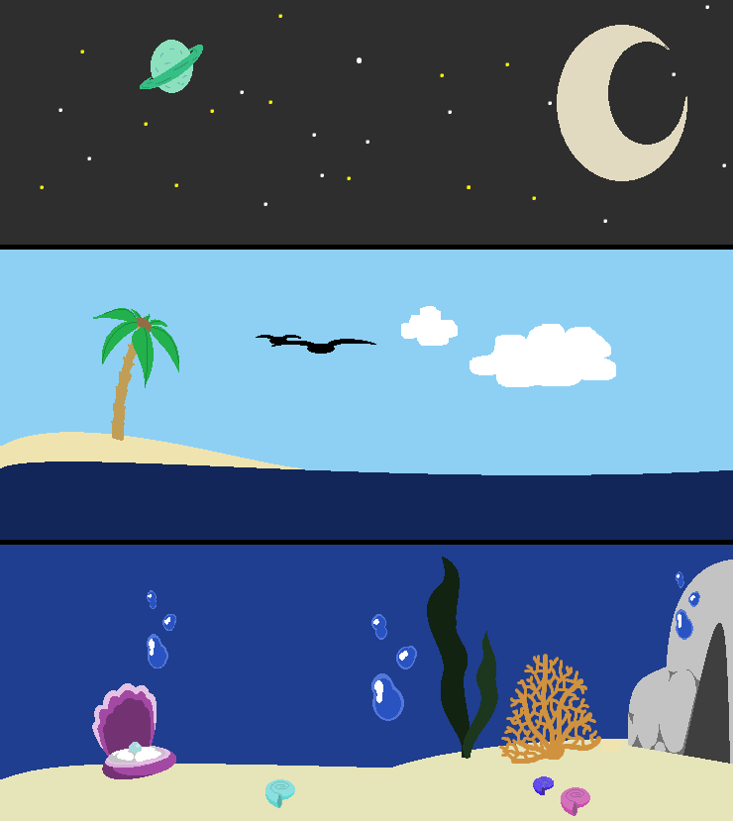
Setting
Setting for 3 difficulties:
- Ocean
- Surface
- Space

Slide 6

Main Character
Dazzle
A young starfish who wants to become a star high in the sky.

Slide 7
CHALLENGES
Procedural Tile/Platform Generator scaling with increasing Score at run time.
Difficulty balancing.
Maintaining a consistent art style; making sure everything looks coherent together.
Creating fitting and high-quality music and sounds

Slide 8
Beat chart

Slide 9
Code Architecture

Slide 10


Working Platform

